Slide 1
Practical considerations
Hung-Hsuan Chen

Slide 2
One-hot encoding
Consider one-hot encoding categorical data (depending on the learning algorithm)
E.g., the values of the ”nationality” feature: “UK”, “Japan”, “Mexico”
We may encode UK as “1,0,0”, Japan as “0,1,0”, and “Mexico” as “0,0,1”
“Nationality feature” becomes three features: “UK or not”, “Japan or not”, “Mexico or not”

Slide 3
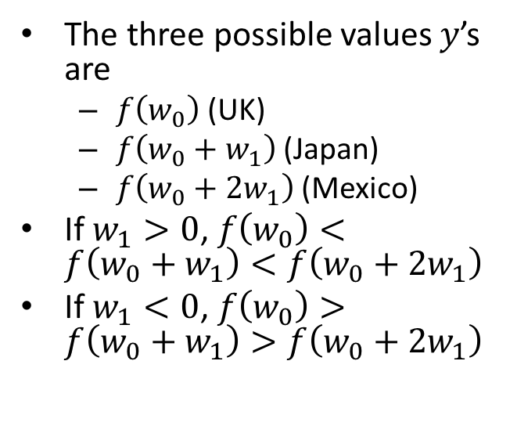
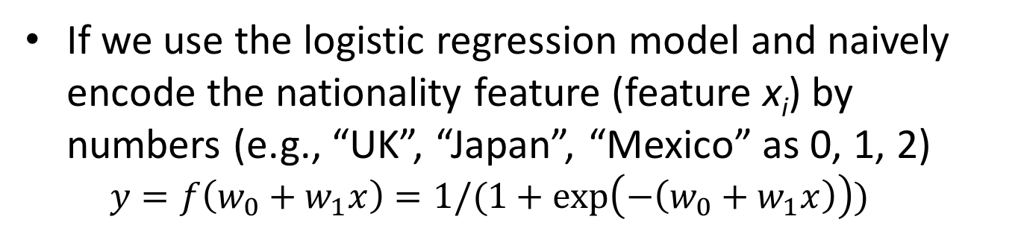
What if we encode categorical features by natural numbers?
If we use the logistic regression model and naively encode the nationality feature (feature x_{i}) by numbers (e.g., “UK”, “Japan”, “Mexico” as 0, 1, 2)
$$y=f\left(w_{0}+w_{1}x\right)=1/(1+\exp\left(−\left(w_{0}+w_{1}x\right)\right))$$
The three possible values $y$’s are
$f\left(w_{0}\right)$ (UK)
$f\left(w_{0}+w_{1}\right)$ (Japan)
$f\left(w_{0}+2w_{1}\right)$ (Mexico)
If $w_{1}>0$, $f\left(w_{0}\right)<f\left(w_{0}+w_{1}\right)<f\left(w_{0}+2w_{1}\right)$
If $w_{1}<0$, $f\left(w_{0}\right)>f\left(w_{0}+w_{1}\right)>f\left(w_{0}+2w_{1}\right)$
The distance between (UK, Mexico) is always larger than (UK, Japan)
It is impossible to group (UK, Mexico) in one class, and (Japan) in the other

Slide 4
Frequency encoding
Encode each categorical feature by its appearance frequency
Useful when frequency is related with the target
E.g., predict salary of an employee based on rank
A company has few high-ranked positions
A company has many low-ranked positions
Salary might be inversely correlated with number of such positions in a company

Slide 5
Combining categorical features
Feature 1 | Feature 2 | Generated feature
A | Y | AY
B | N | BN
A | N | AN
C | Y | CY
AY | AN | BY | BN | CY | CN
1 | 0 | 0 | 0 | 0 | 0
0 | 0 | 0 | 1 | 0 | 0
0 | 1 | 0 | 0 | 0 | 0
0 | 0 | 0 | 0 | 1 | 0

Slide 6
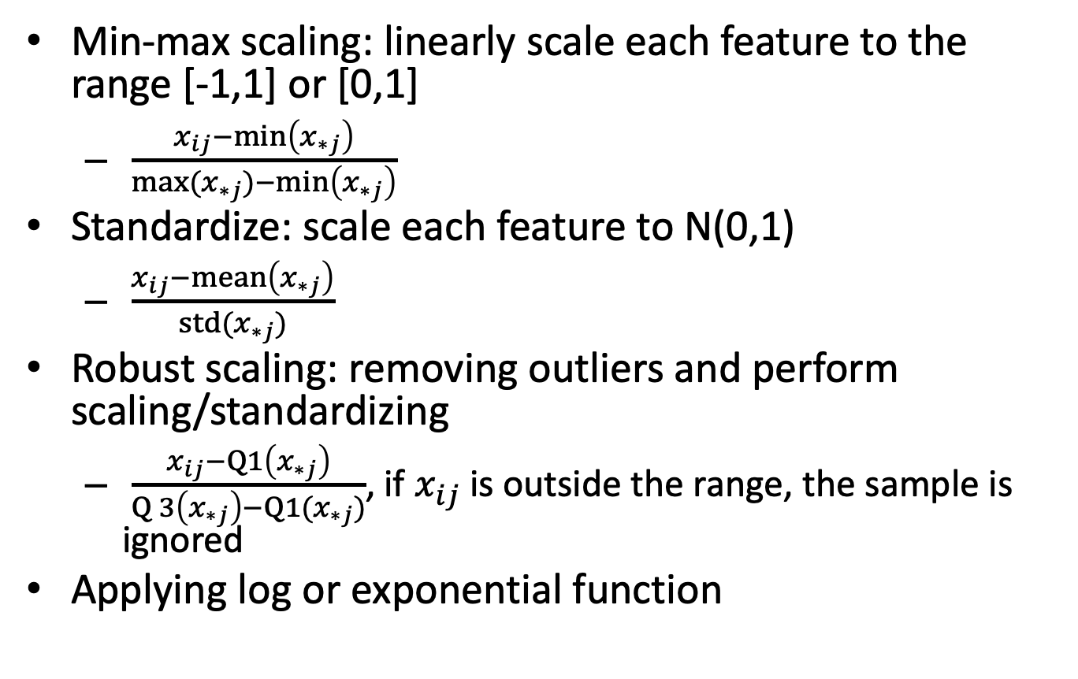
Transforming numerical features
Min-max scaling: linearly scale each feature to the range [-1,1] or [0,1]
$\frac{x_{ij}−\min\left(x_{∗j}\right)}{max⁡(x_{∗j})−\min\left(x_{∗j}\right)}$
Standardize: scale each feature to N(0,1)
$\frac{x_{ij}−\operatorname{mean}\left(x_{∗j}\right)}{std⁡(x_{∗j})}$
Robust scaling: removing outliers and perform scaling/standardizing
$\frac{x_{ij}−Q1\left(x_{∗j}\right)}{Q3\left(x_{∗j}\right)−Q1⁡(x_{∗j})}$, if $x_{ij}$ is outside the range, the sample is ignored
Applying log or exponential function

Slide 7
Why scaling or standardize?
For KNN, scaling prevents the distance scores being dominated by few features
For linear regression, logistic regression, SVM, scaling helps
Numerical optimization
Prevent normalization value being dominated by few parameters
For decision trees and random forest, scaling or not is not important

Slide 8
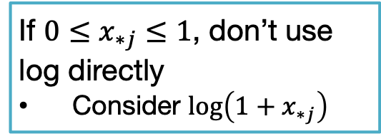
More about log or exp functions
Apply log or exponential functions to make the skewed features Gaussian-like
If ${0≤x}_{∗j}≤1$, don’t use log directly
Consider $log\left(1+x_{∗j}\right)$
http://www.esri.com/news/arcuser/0111/findmodel .html

Slide 9
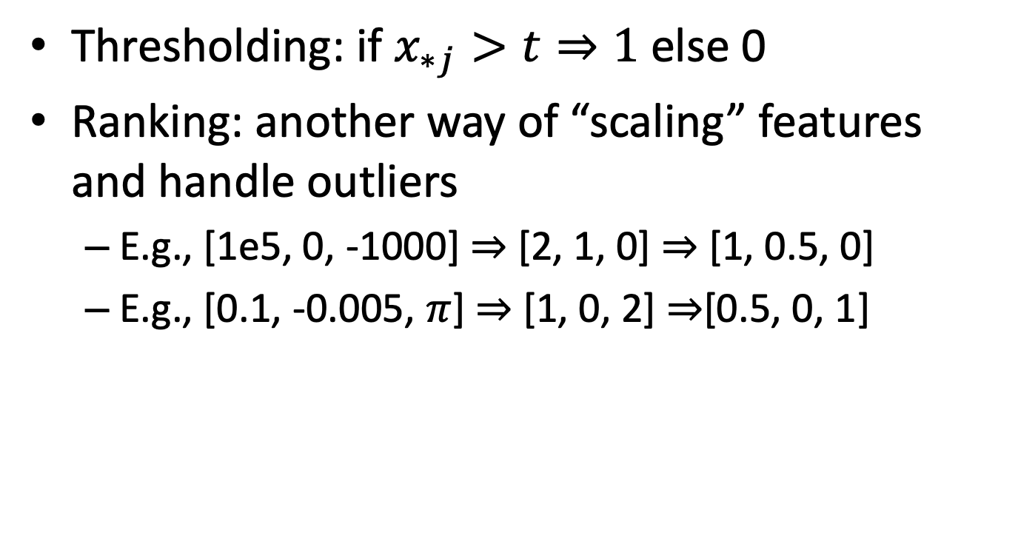
Thresholding and ranking
Thresholding: if $x_{∗j}>t⇒1$ else 0
Ranking: another way of “scaling” features and handle outliers
E.g., [1e5, 0, -1000] $⇒$ [2, 1, 0] $⇒$ [1, 0.5, 0]
E.g., [0.1, -0.005, $π$] $⇒$ [1, 0, 2] $⇒$[0.5, 0, 1]

Slide 10
Another interesting technique
Keep only the integer part of the numbers
E.g., 3.99 ➔ 3; 3.01 ➔ 3; 1.99 ➔ 1
Keep only the fractional part of numbers
E.g., 3.99 ➔ .99; 3.01 ➔ .01; 1.99 ➔ .99
Might be useful to capture human’s subconsciousness to numbers (e.g., price)

Slide 11
Transforming feature values to Gaussian distribution
GausRank
Michael Jahrer proposed in “Porto Seguro’s Safe Driver Prediction” ($25,000 prize money)
Procedure
Sort the original features, use “order” to replace the original feature values
Feature value becomes uniformly distributed
Scale the order values to be within (-1, 1)
Apply erf-inverse function

Slide 12
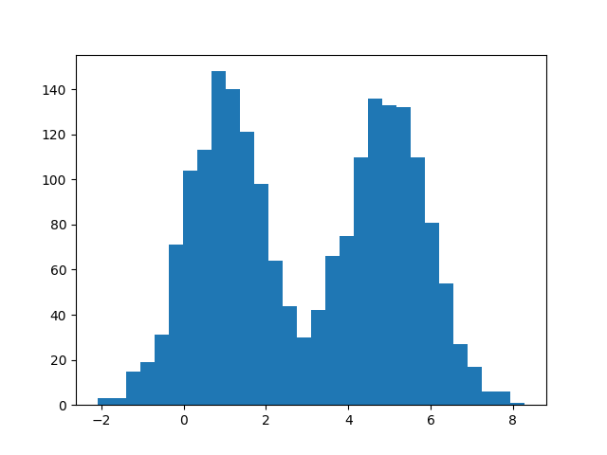
RankGaus example (1/2)
x = np.concatenate((np.random.normal(1, 1, 1000), np.random.normal(5, 1, 1000)))
rank_x = scipy.stats.rankdata(x)
E.g., if x = [100, 80, 60, 70, 90], scipy.stats.rankdata(x) outputs [5, 3, 1, 2, 4]

Slide 13
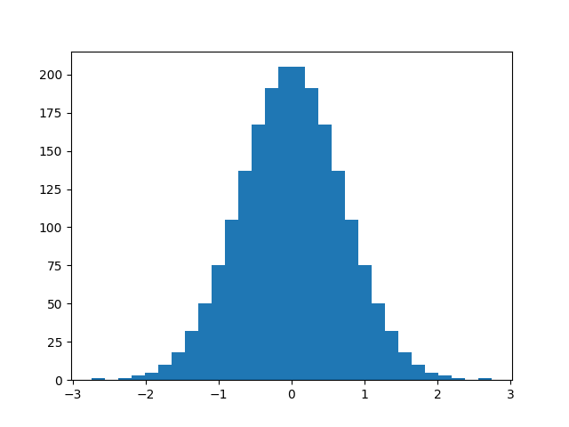
RankGaus example (2/2)
x = np.concatenate((np.random.normal(1, 1, 1000), np.random.normal(5, 1, 1000)))
rank_x = scipy.stats.rankdata(x)
scaled_x = 2*0.9999*(rank_x - rank_x.mean()) / (rank_x.max() - rank_x.min())
new_x = scipy.special.erfinv(scaled_x)

Slide 14
Missing values
If the type of the feature is categorical
Replace the missing values with the most frequent value
If the type of the feature is numerical
Replace the missing values with the mean or median
Some more advanced techniques
Predict the missing values, usually by interpolation and extrapolation

Slide 15
Imbalanced classification
Most classification algorithms perform optimally when the number of samples in each class is similar
Common techniques for imbalanced dataset
Under-sample the majority class
Over-sample the minority class
A combination of both under-sampling and over-sampling
Some more advanced techniques
“Generate” simulated instances from the minority class

Slide 16
Selecting user-specified parameters (hyper-parameters)
Examples of hyper-parameters
K in KNN
C in the regularized linear classification
Step size in gradient descent
Select hyper-parameters
Strategies
Grid search
Random search
Bayesian optimization
Parallelism: train each parameter setting independently
Testing selected hyper-parameters
Cross validation
Parallelism: validate each parameter setting independently

Slide 17
Selecting hyper-parameters
Grid search
A fancy name of exhaustive search
Manually specify subset of the hyper-parameter space and step size
Try all parameter combinations and check their performance (by cross-validation)
Random search
Surprisingly good performance
Among the tunable parameters, important ones are only a few

Slide 18
Selecting hyper-parameters (cont’)
Bayesian optimization
Iteratively picking hyper-parameters for experiments
Picking strategy: tradeoff between
Exploration (hyper-parameters for which the outcome is most uncertain), and
Exploitation (hyper-parameters which are expected to have a good outcome)

Slide 19
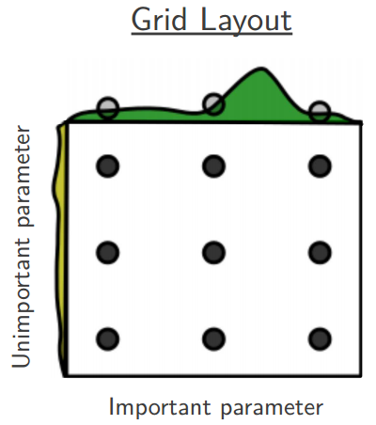
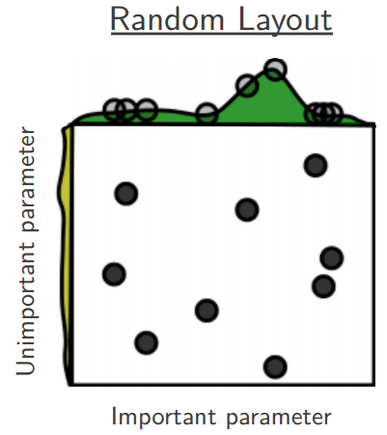
Random search is surprisingly good
Bergstra and Bengio. "Random search for hyper-parameter optimization." JMLR 2012

Slide 20
Validating selected hyper-parameters
Use only training data to select hyper-parameters
Overfit training data
Use training data with different hyper-parameters to train models, and test performance based on test data
Overfit test data
The hyper-parameters are tweaked until the estimator performs well
Knowledge of the test data is “leaked”

Slide 21
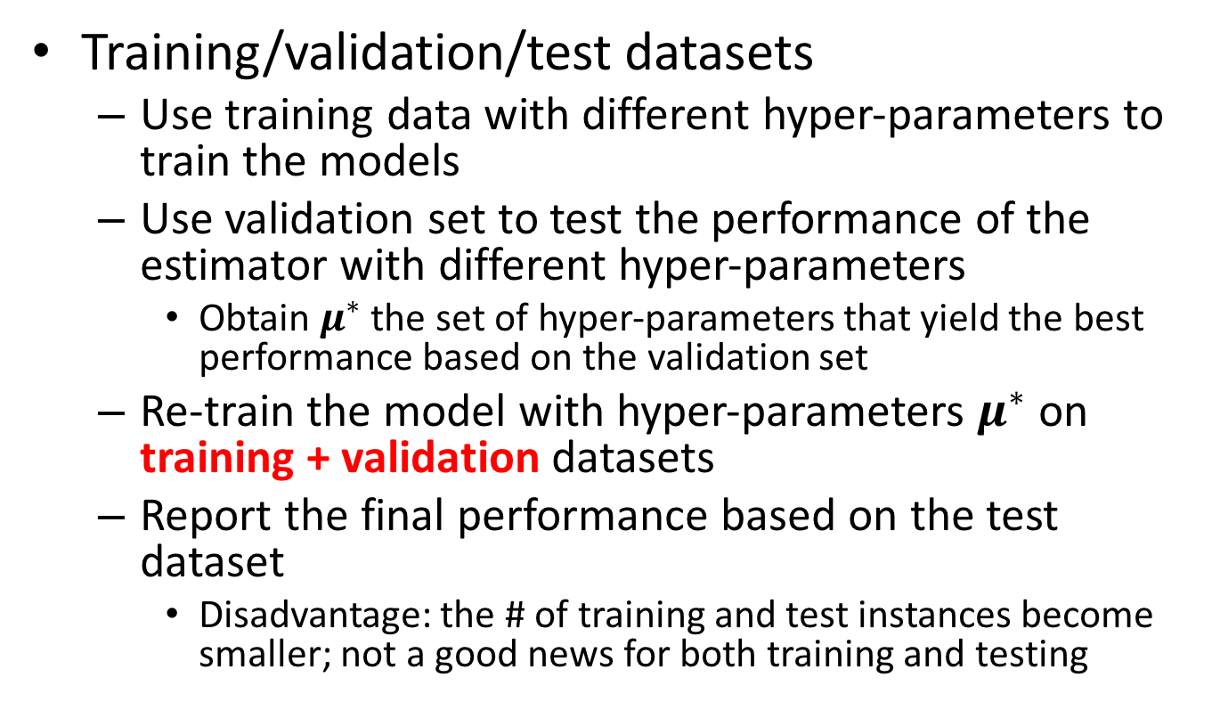
Validating selected hyper-parameters (cont’)
Training/validation/test datasets
Use training data with different hyper-parameters to train the models
Use validation set to test the performance of the estimator with different hyper-parameters
Obtain $μ^{∗}$ the set of hyper-parameters that yield the best performance based on the validation set
Re-train the model with hyper-parameters $μ^{∗}$ on training + validation datasets
Report the final performance based on the test dataset
Disadvantage: the # of training and test instances become smaller; not a good news for both training and testing

Slide 22
Figure source: http://magizbox.com/training/machinelearning/site/evaluation/

Slide 23
Training/validation/testing

Slide 24
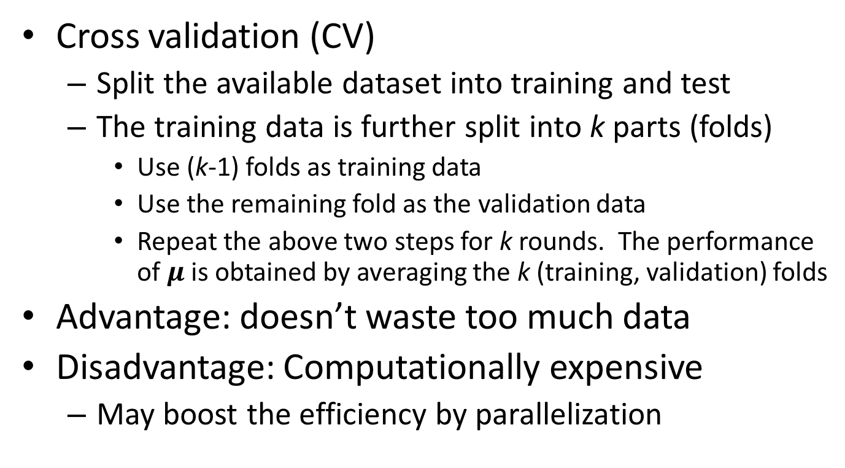
Validating selected hyper-parameters (cont’)
Cross validation (CV)
Split the available dataset into training and test
The training data is further split into k parts (folds)
Use (k-1) folds as training data
Use the remaining fold as the validation data
Repeat the above two steps for k rounds. The performance of $μ$ is obtained by averaging the k (training, validation) folds
Advantage: doesn’t waste too much data
Disadvantage: Computationally expensive
May boost the efficiency by parallelization

Slide 25
K-fold cross validation

Slide 26
Cross validation
Types of cross-validation
K-fold
K is typically set to 5 or 10
Leave-one-out (LOO)
Setting k equals n the number of data instances
Leave-P-out (LPO)
P out of n is regarded as the validation set for each round. The procedure produces C(n, P) train-validate pairs.
Stratification
Create splits by preserving the approximately the same percentage of each target label as in the complete dataset
Time series data
Training dataset should contain only the “old” instances; the validation dataset contains the “new” instances

Slide 27
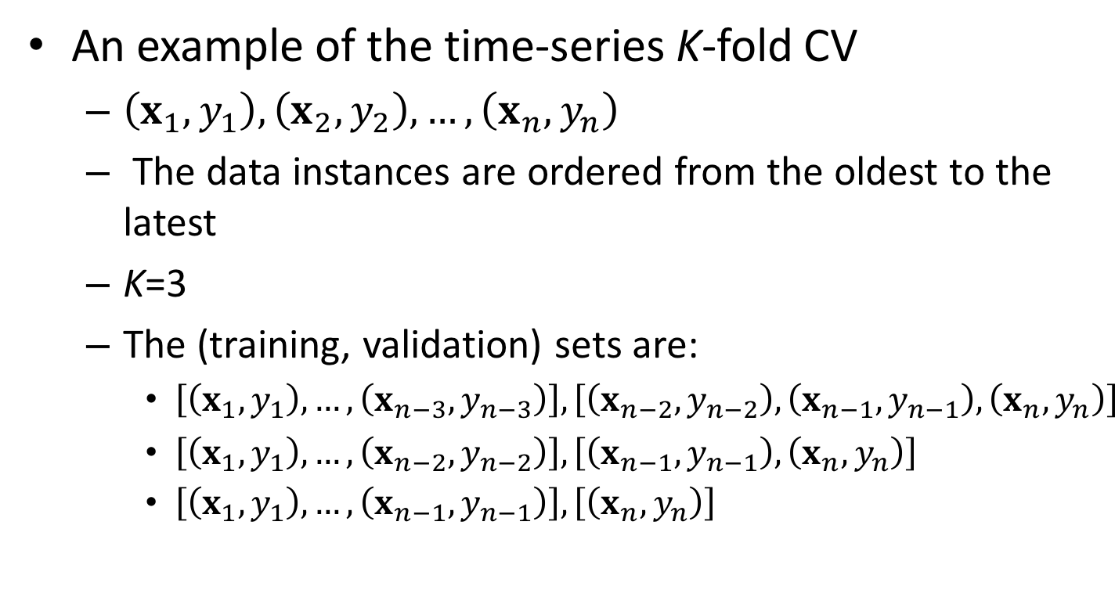
Cross validation (cont’)
An example of the time-series K-fold CV
$\left(x_{1},y_{1}\right),\left(x_{2},y_{2}\right), …, \left(x_{n},y_{n}\right)$
The data instances are ordered from the oldest to the latest
K=3
The (training, validation) sets are:
$\left[\left(x_{1},y_{1}\right), …, \left(x_{n−3}, y_{n−3}\right)\right], \left[\left(x_{n−2}, y_{n−2}\right), \left(x_{n−1}, y_{n−1}\right), \left(x_{n},y_{n}\right)\right]$
$\left[\left(x_{1},y_{1}\right), …, \left(x_{n−2}, y_{n−2}\right)\right], \left[\left(x_{n−1}, y_{n−1}\right), \left(x_{n},y_{n}\right)\right]$
$\left[\left(x_{1},y_{1}\right), …, \left(x_{n−1}, y_{n−1}\right)\right], \left[\left(x_{n},y_{n}\right)\right]$

Slide 28
Nested cross validation

Slide 29
Three scenarios of evaluation
Evaluate a simple model w/o hyper-parameters
Split into training and test data
Evaluate a model with hyper-parameters
Split into training and test data
Apply K-fold cross validation on the training data to find the best hyper-parameters
Re-train the training data based on the best hyper-parameters, and evaluate the performance on test data
Compare several models with hyper-parameters
Nested cross validation
Source: https://sebastianraschka.com/faq/docs/evaluate-a-model.html

Slide 30
Multi-class classification
Leverage on binary classifiers
One-vs.-rest (aka one-vs-all)
One-vs.-one
Other methods
KNN
Decision trees
Neural networks

Slide 31
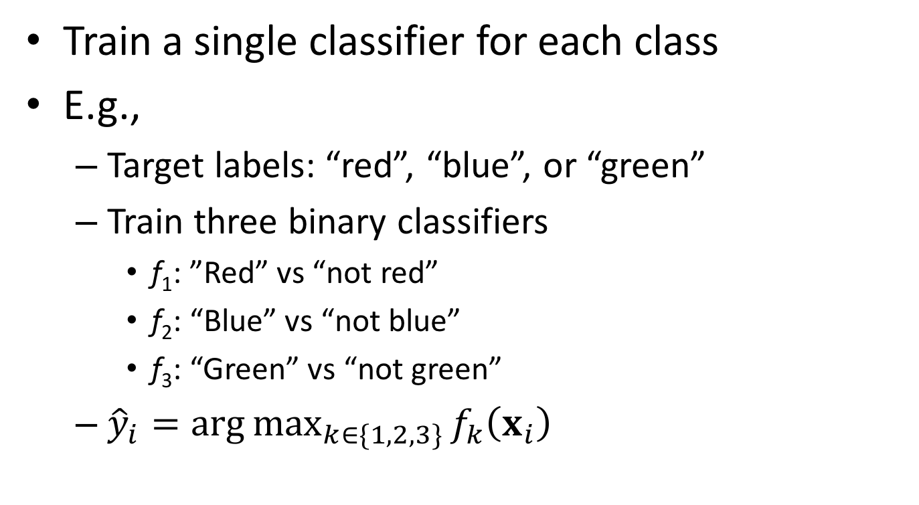
One-vs.-rest (aka: one-vs.-all)
Train a single classifier for each class
E.g.,
Target labels: “red”, “blue”, or “green”
Train three binary classifiers
f₁: ”Red” vs “not red”
f₂: “Blue” vs “not blue”
f₃: “Green” vs “not green”
${\hat{y}}_{i}=\arg{\max_{k∈\{1,2,3\}}{f_{k}\left(x_{i}\right)}}$

Slide 32
One-vs.-one
Training: for a k-nary classification problem, one trains C(k, 2) classifiers
Test:
Feed the test instance to all C(k, 2) classifiers
The class receiving the most “+1” predictions is the predicted class

Slide 33
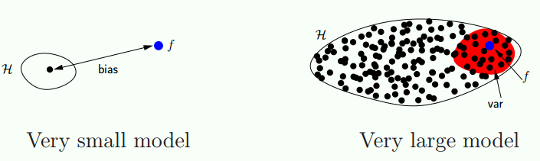
Bias vs variance
The test error comes from
Bias: the error from the difference between the true model and the learning model
Variance: the error from sensitivity to the small fluctuations in the training data
Noise: the error from the data per se.
Yaser S. Abu-Mostafa, Malik Magdon-Ismail, Hsuan-Tien Lin, ”Learning from data.” 2012,

Slide 34
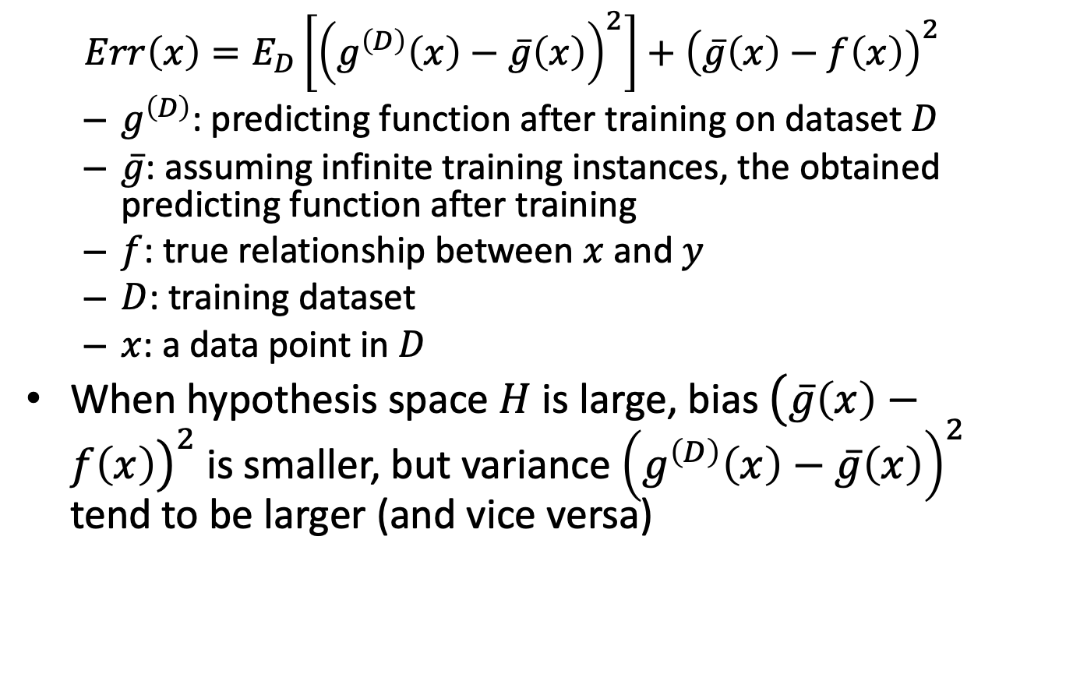
Bias vs variance
$$Err\left(x\right)=E_{D}\left[{\left(g^{\left(D\right)}\left(x\right)−\overline{g}\left(x\right)\right)}^{2}\right]+{\left(\overline{g}\left(x\right)−f\left(x\right)\right)}^{2}$$
$g^{\left(D\right)}$: predicting function after training on dataset $D$
$\overline{g}$: assuming infinite training instances, the obtained predicting function after training
$f$: true relationship between $x$ and $y$
$D$: training dataset
$x$: a data point in $D$
When hypothesis space $H$ is large, bias ${\left(\overline{g}\left(x\right)−f\left(x\right)\right)}^{2}$ is smaller, but variance ${\left(g^{\left(D\right)}\left(x\right)−\overline{g}\left(x\right)\right)}^{2}$ tend to be larger (and vice versa)

Slide 35
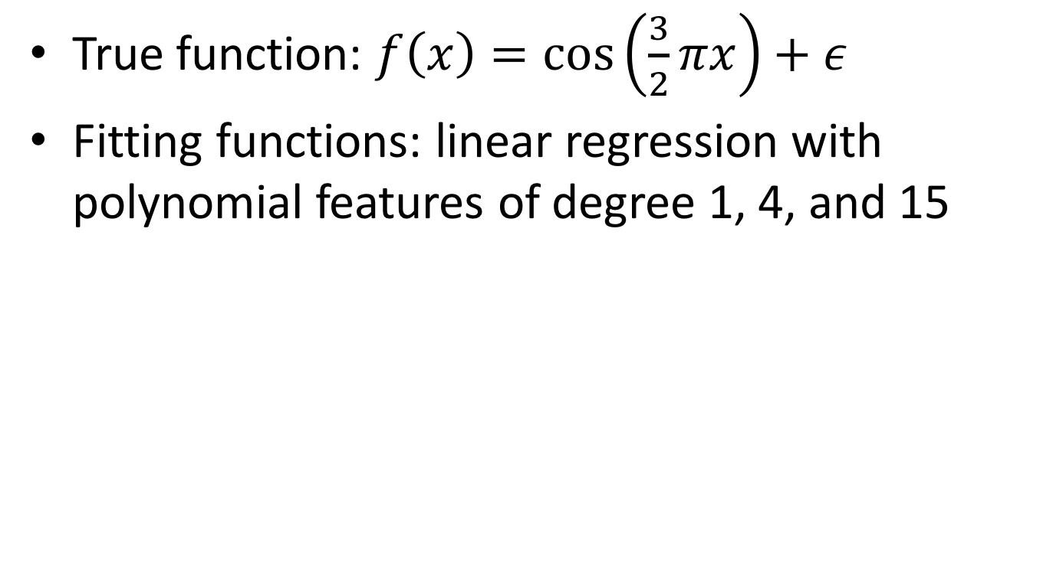
(Bias vs variance) vs (underfit vs overfit)
Source: http://scikit-learn.org/stable/auto_examples/model_selection/plot_underfitting_overfitting.html
True function: $f\left(x\right)=\cos\left(\frac{3}{2}πx\right)+ε$
Fitting functions: linear regression with polynomial features of degree 1, 4, and 15
Underfit
High bias
Low variance
Overfit
Low bias
High variance

Slide 36
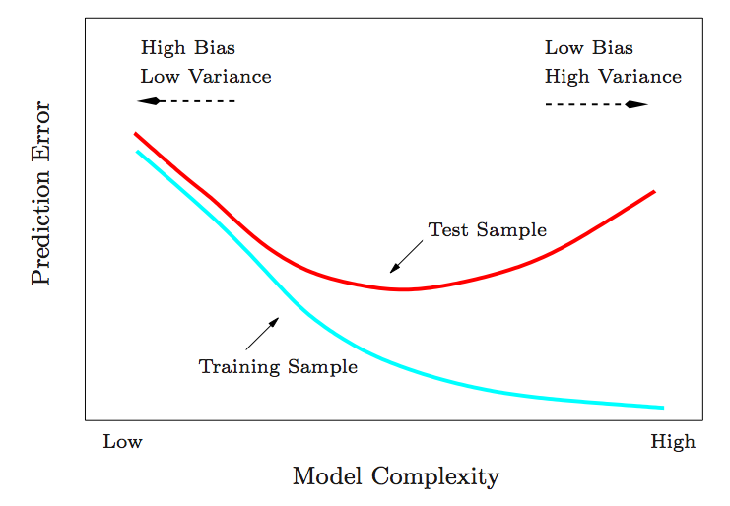
Model complexity and over/under-fitting
Hastie et al., “The Elements of Statistical Learning.” 2001.

Slide 37
Training size and over/under-fitting
Error
Test error
Training error
Training data size

Slide 38
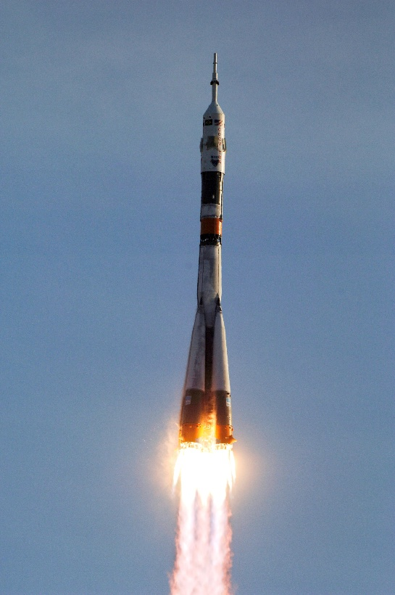
Data size vs model complexity
Does it do well on the training data?
Yes
Does it do well on the test data?
Yes
Done!
No
No
More complex model
(Rocket engine)
More data
(Rocket fuel)
Modified from the slides of Dr. Andrew Ng’s talk at the GPU Technology Conference 2015

Slide 39
Model selection
Domain knowledge is important
If you know the relationship between x and y is linear, why choose quadratic?
Data size is important
Applying complex models on small data tends to over-fitting
Applying simple models on massive data tends to under-fitting
Select an algorithm that is
complex enough to fit the training data well, and
simple enough to fit the testing (future) data well

Slide 40
Quiz
If we find a model performs well on training data but poorly on test data
Increase or decrease model complexity?
Collect more data?
If we find a model performs roughly the same on both training and testing datasets, and we believe the current accuracy is not good enough
Collecting more data?
Increasing model complexity and collecting more data for training?

Slide 41
Quiz
A student write a research paper is the following way
Find a problem
Collect experimental data for the problem
Propose a method for the problem
Compare the proposed method with previous methods, based on the collected data
If failed, go to step 4 and try different hyper-parameters
New publication and graduate!
Is this fair?

